Slide 1
Virtualization Technology
Recently Rookit with Virtualization Technology
Maple(www.Wowhacker.com)

Slide 2
Virtualization Technology
Emulation
Full-Virtualization
Para-Virtualization
Hardware-Assistant Virtualization
NOW!

Slide 3
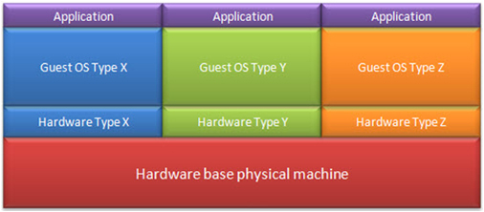
Emulation
Emulation

Slide 4
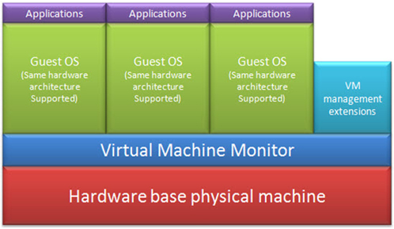
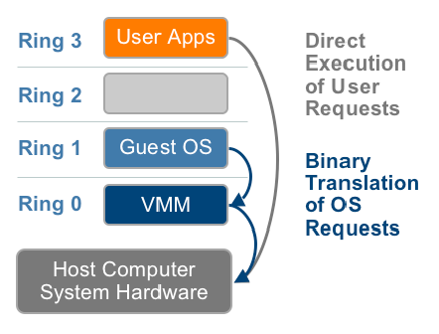
Full-Virtualization
Full-Virtualization
Using Binary Translation
: User 레벨의 요청은 바로 수행.
: OS 레벨의 요청은 Binary Tranlation 을 거쳐 VMM이 담당한다.

Slide 5
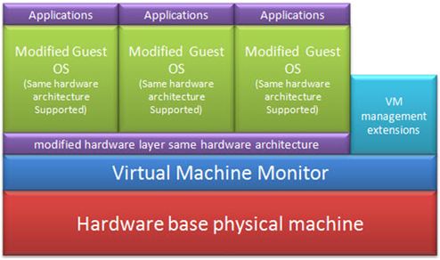
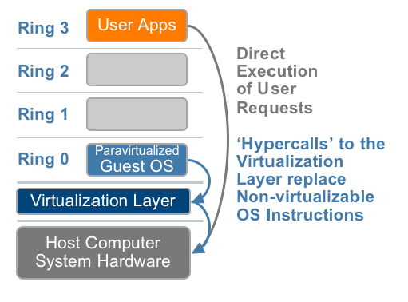
Para-Virtualization
Para-Virtualization
OS를 수정하여, Systemcalls -> Hypercalls
: Binary Translation 을 거치지 않아 비교적 빠르다.
: User 요청은 여전히 바로 수행된다.

Slide 6
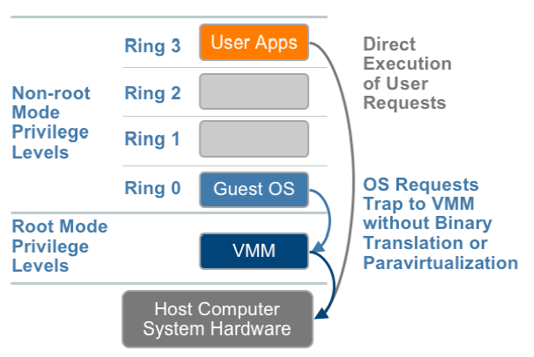
Hardware-Assist Virtualization
AMD Pacifica
Focus on SKINIT
INTEL VT-X
Focus on SENTER

Slide 7
What is Hardware-Assist Virtualization
Root / Non-Root Mode
VMM ( Virtual Machine Monitor )
VMCB in AMD, VMCS in INTEL
Virtual Machine(guest)’s descriptor
Include following things :
guest에게서 가로챌 명령이나 이벤트 리스트(예.write to CR3)
guest의 실행 환경을 타나내는 다양한 제어 비트들이나 guest code가 수행되기 전에 취해질 특별한 동작들에 대한 비트등
Guest 프로세서 상태 ( control register 등등.. )
I/O support by Architecture
External Access Protection ( eg., DMA )

Slide 8
How work Hardware-Assist Virtualization
Setup VMCB or VMCS
Include Intercept instruction list
See Architecture vendor’s reference manual
VMRUN or VMLAUNCH
Into the Guest mode( Virtual Machine )
Execute Guest’s Code
#VMEXIT
Back to Host mode( Real Machine )
Execute Host’s Code
Intercepted Event or Interrupt dispatch

Slide 9
So, What?

Slide 10
RING -1
HVM Rootkit
Bluepill Project

Slide 11
What is HVM
HVM
= Hardware-assisted virtualization

Slide 12
BLUEPILL

Slide 13
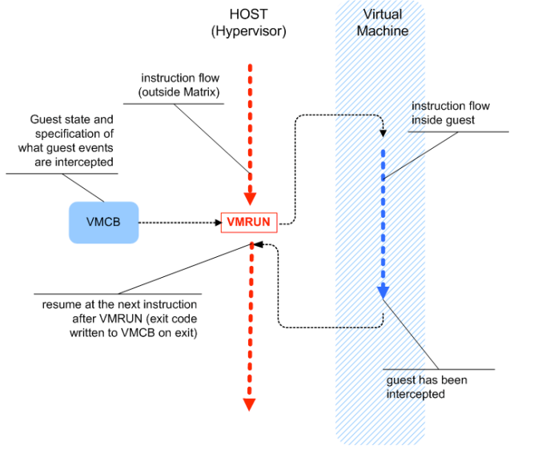
Hardware-Assist means
Normal
Usage

Slide 14
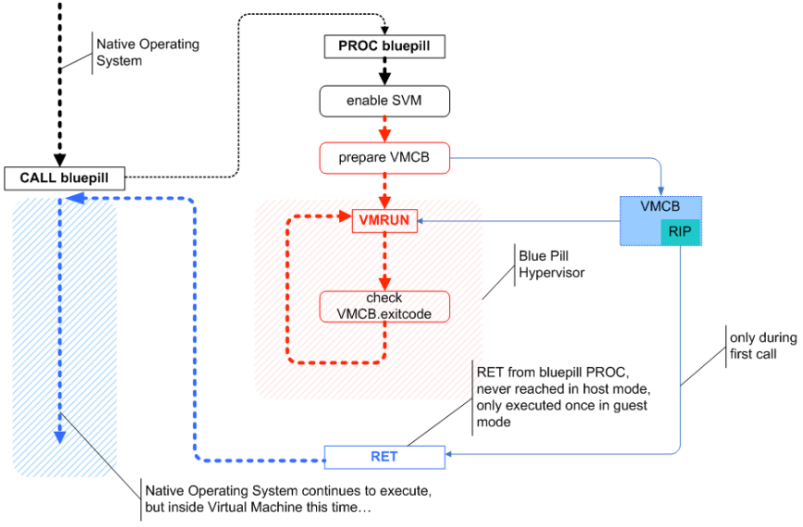
Back to The Matrix

Slide 15
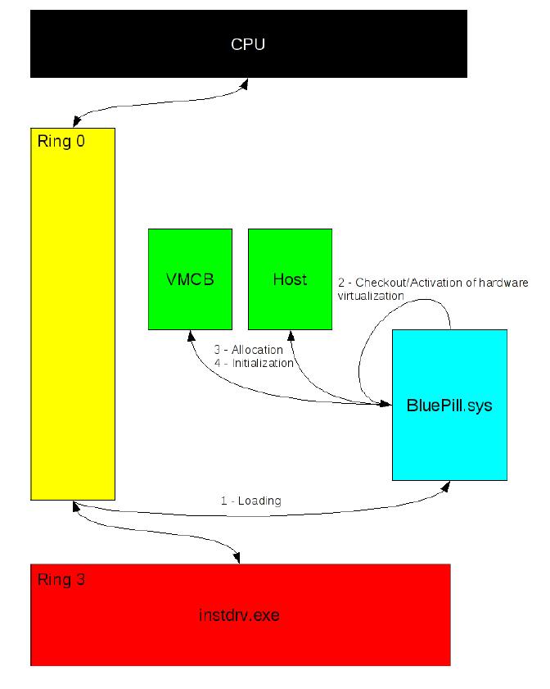
BLUEPILL Argorithm -1

Slide 16
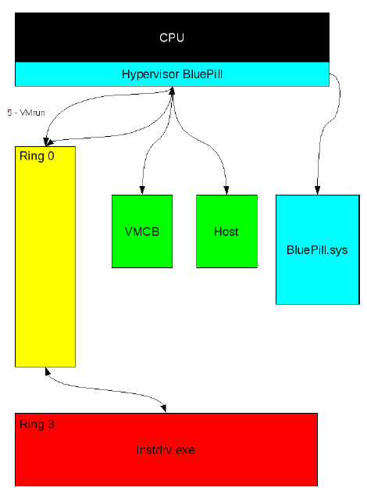
BLUEPILL Argorithm -2

Slide 17
How to Solve?
AMD
Secure Virtual Machine Architecture (SVM)
INTEL
Trust Execution Technology (TXT)
With TPM ( Trusted Platform Module )

Slide 18
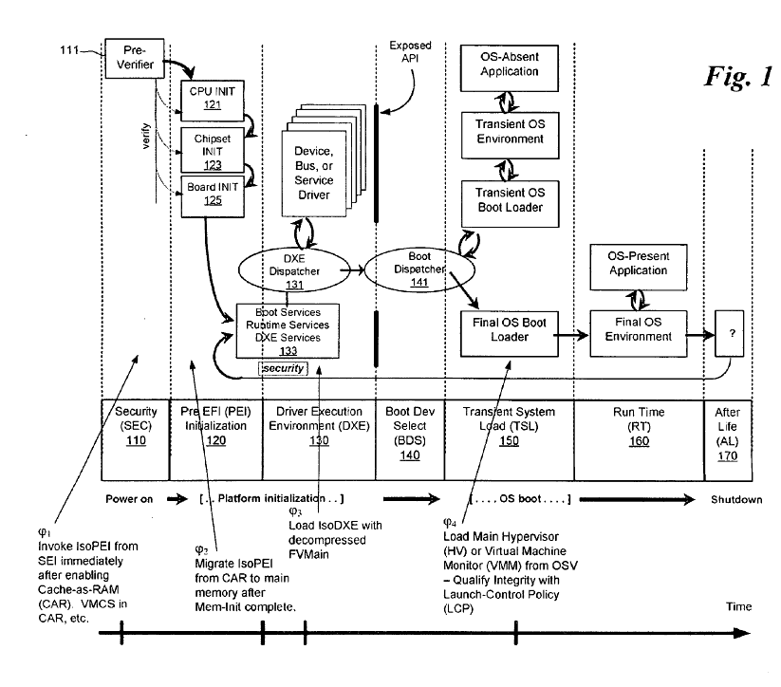
INTEL TXT Overview

Slide 19
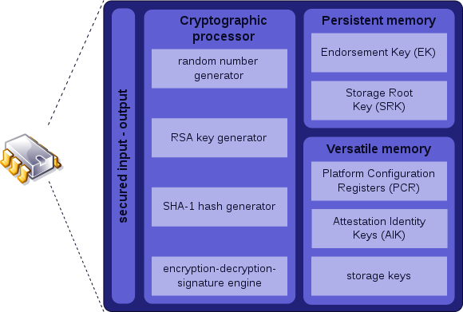
TPM Overview

Slide 20
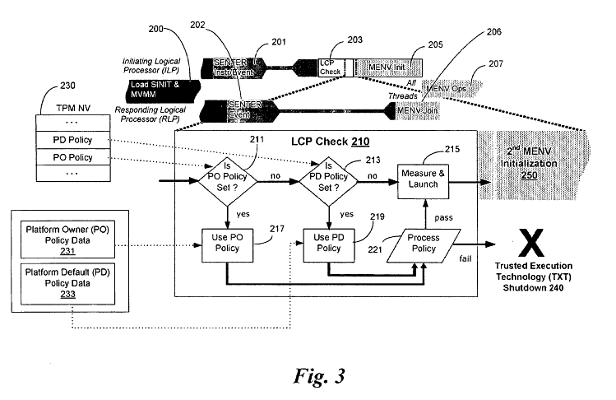
INTEL TXT with TPM

Slide 21
RING -2
SMM Rootkit

Slide 22
What is SMM
System Management Mode
일반적인 모든 실행 (운영 체제를 비롯)을 일시 중단하고 구별된 특별한 소프트웨어(보통 펌웨어나 하드웨어 보조 디버거)가 높은 권한으로 실행된다.

Slide 23
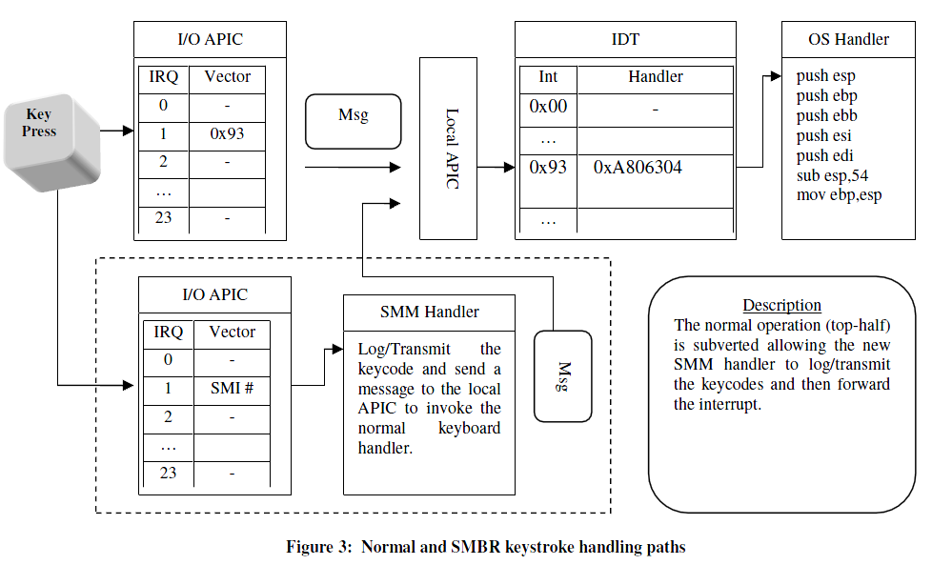
Normal SMM case

Slide 24
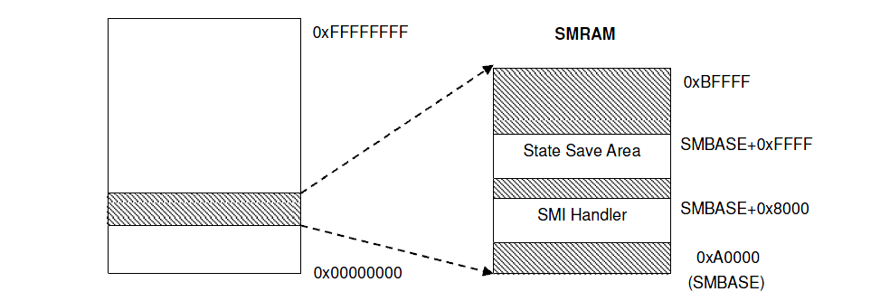
SMM layout of past

Slide 25
Current Layout
5GB
SMRAM
4GB
MMIO
Processor’s View
DRAM

Slide 26
Memory Remapping Bug
5GB
SMRAM
Possible in Q35
4GB
MMIO
SMRAM
Not Availiable
Processor’s View
DRAM

Slide 27
Hypervisor with SMM
SVM&TXT
Hypervisor (VMM)
STM ( SMM Transfer Monitor )
SMI
Communication
Protocol
SMM

Slide 28
RING -3
AMT with INTEL
Another is Noway

Slide 29
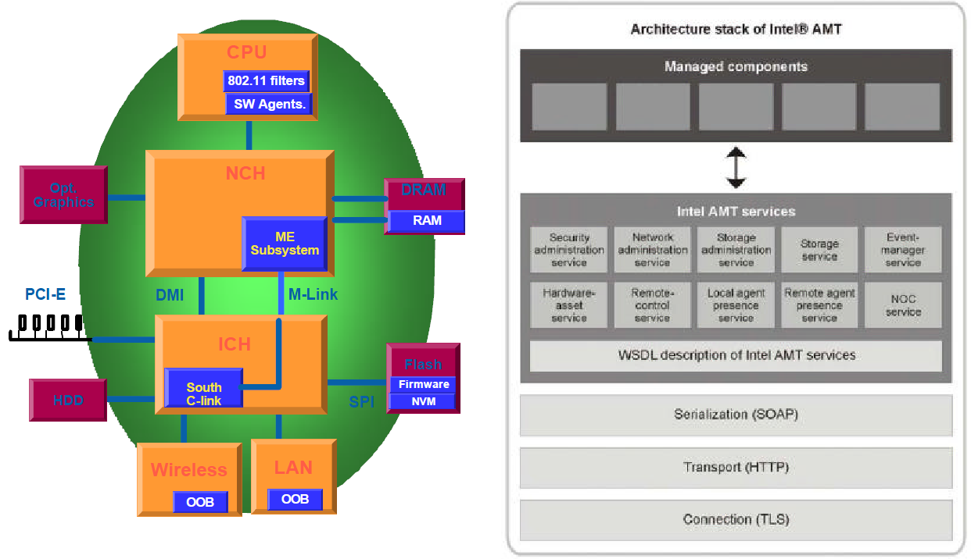
What is AMT
AMT
Active Management Technology

Slide 30
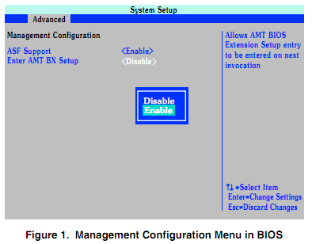
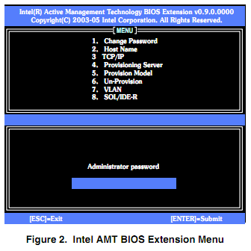
AMT Example
Setup enable for AMT

Slide 31
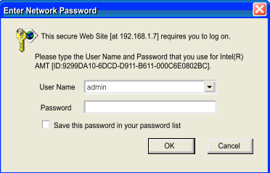
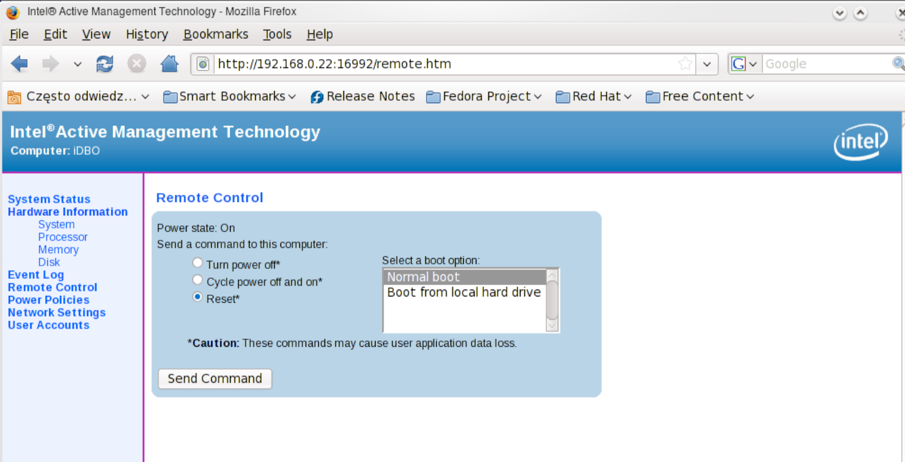
AMT Example

Slide 32
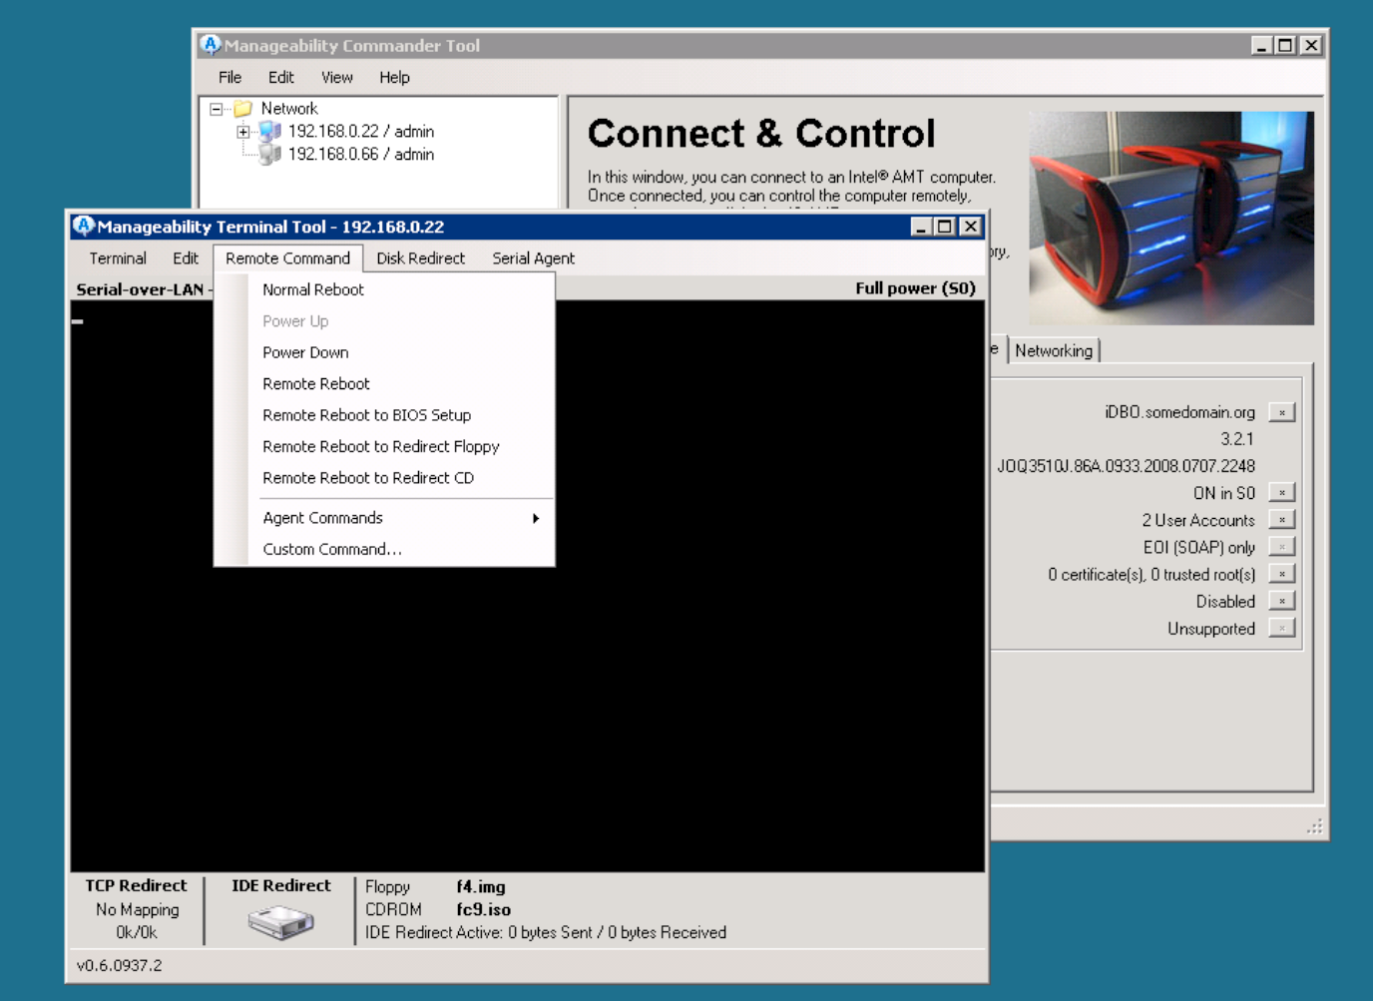

Slide 33
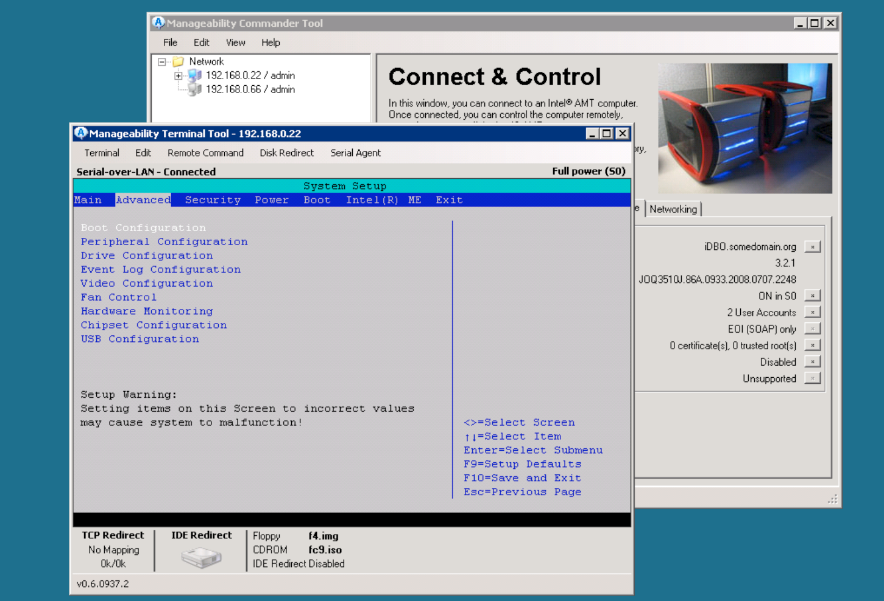

Slide 34
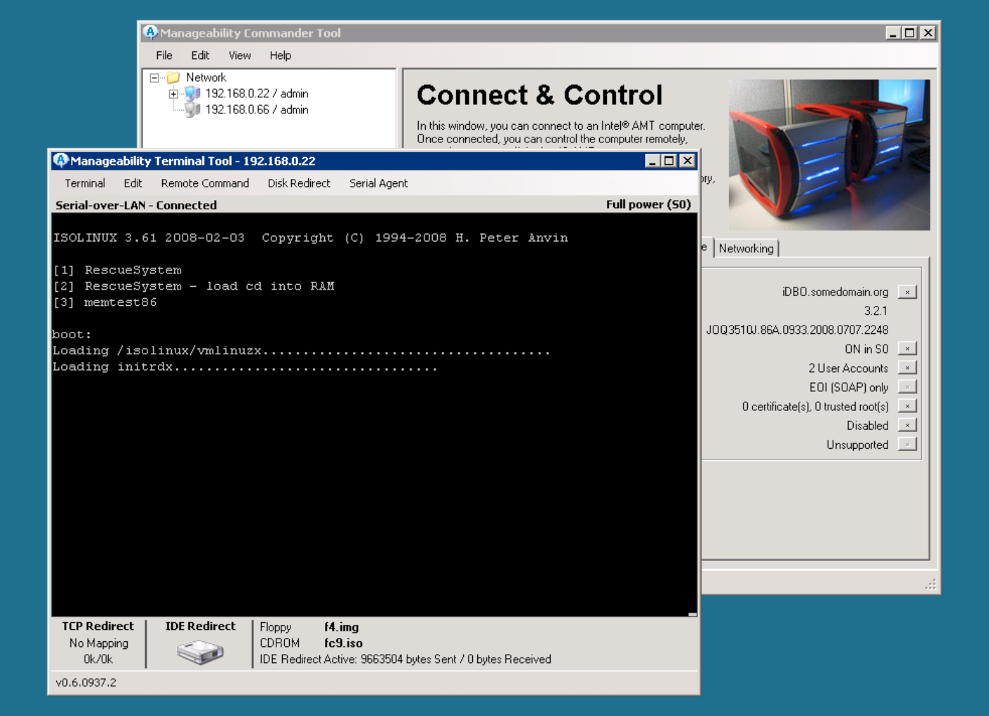

Slide 36
Security With Hypervisor
The GOD observe you

Slide 37
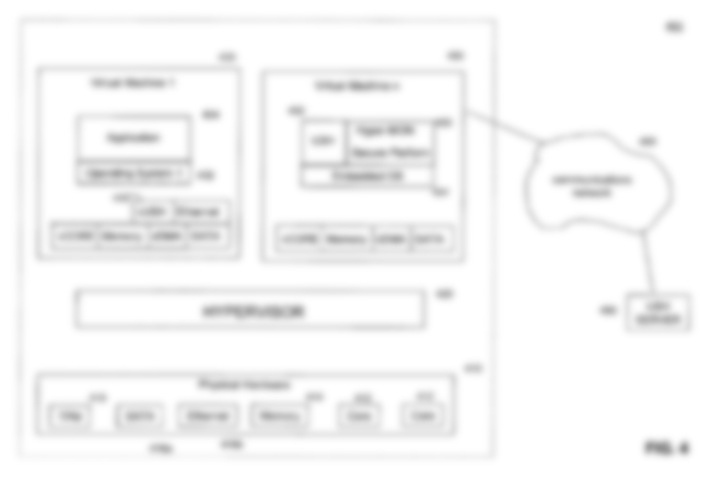
Security With Hypervisor
The Hypervisor
Can
Do all-thing
Eg., I/O control
Network filtering
Denied untrusted software
, and so on…

Slide 38
Security With Hypervisor
Can't feel Like
the people
that living in Matrix
Eg., Jangja is navi in the dream.
We call that HOJUBMONG

Slide 39
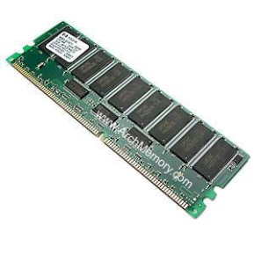
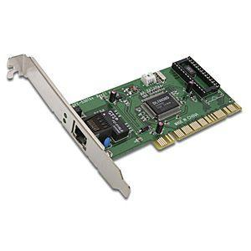
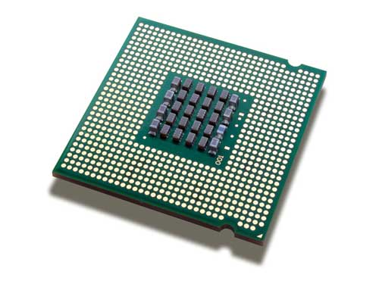
Imagine
NETWORK
Hypervisor
For
Security
OS
Virtual-Devices
Virtual-Storage
Real-Storage

Slide 40
END
감사감사

